Slide 1
Wireframe
Student’s Portfolio
Content Functions

Slide 2
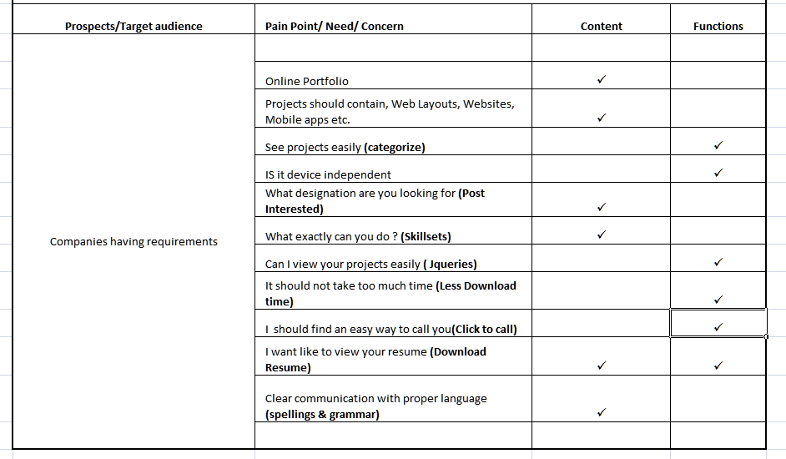

User Research for Content & Functions

Slide 3

Home page
UI Designer / UI Developer
Portfolio for the post of UI Designer
Student’s Name
Responsive Navigation
About My Education and skills
Student’s Photo
Resume Download (CTA)
Check my projects
Live Project
Very Important Projects
Mobile will Dial the mention phone number on touch
Touch to Call – 0000 000 000

Slide 4
Home page - After scrolling
Student’s Name (UI Designer)
Web Sites
Web Layouts
Header & Footer will be Fix (will not move while scrolling)
Sequence of projects as per importance
E-Mailers
Mobile App Design
Branding
Touch to Call – 0000 000 000

Slide 5
Websites page
Student’s Name (UI Designer)
Image/ icon/Logo Of Company
Websites
Tap will open Website in the new browser window
One
Two
Details of Website
Name of company
Type of Company
Technologies used
Student’s role and credits
Three
Touch to Call – 0000 000 000

Slide 6
Web Layout1 page
Student’s Name (UI Designer)
Web Layouts
Link will open images in the light box JQuery
Own Designs
Details of Website
Technologies used
Student’s role and credits
Remakes
Touch to Call – 0000 000 000

Slide 7
Web Layout2 page
Student’s Name (UI Designer)
Web Layouts
Image in full view
Full Image in
LightBox JQuery
Back to Web Layouts Page
Details of Project
Technologies used
Student’s role and credits
Previous & Next Icons to view all images
Touch to Call – 0000 000 000

Slide 8
E-mailers1 page
Student’s Name (UI Designer)
E-mailer Design
Link will open images in the light box JQuery
Own Designs
Details of Website
Technologies used
Student’s role and credits
Remakes
Touch to Call – 0000 000 000

Slide 9
E-mailers2 page
Student’s Name (UI Designer)
E-mailer Design
Full Image in
LightBox JQuery
Touch to Call – 0000 000 000

Slide 10
UI Design1 page
Student’s Name (UI Designer)
UI Design
Link will open images in the light box JQuery
Wireframes
Details of Project
Name of company
Type of Company
Technologies used
Student’s role and credits
Layouts from
wireframe above
Touch to Call – 0000 000 000

Slide 11
UI Design2 page
Student’s Name (UI Designer)
UI Design
Full Image in
LightBox JQuery
Touch to Call – 0000 000 000

Slide 12
Live Project Page
Student’s Name (UI Designer)
Live Project
Details of Website
Technologies used
Student’s role and credits
Wireframe of Homepage
Link will open images (wireframe & Layout) in the light box JQuery
Layout of Homepage
Link will open website in a new browser window
Touch to Call – 0000 000 000

Slide 13
Mobile App1 Design
Student’s Name (UI Designer)
Mobile App Design
Link will open images (wireframes & layouts) in the light box JQuery
Own Designs
Details of Apps
Technologies used
Student’s role and credits
Remakes
Touch to Call – 0000 000 000

Slide 14
Mobile App2 page
Student’s Name (UI Designer)
Mobile App Design
Full Image in
LightBox JQuery
Touch to Call – 0000 000 000

Slide 15
Branding Design1 Page
Student’s Name (UI Designer)
Branding Design
Link will open images (wireframes & layouts) in the light box JQuery
Own Designs
Details of Website
Technologies used
Student’s role and credits
Remakes
Touch to Call – 0000 000 000

Slide 16
Branding Design2 page
Student’s Name (UI Designer)
Branding Design
Full Image in
LightBox JQuery
Touch to Call – 0000 000 000

Slide 17
Navigations
Home
About Me
Contact Me
Touch to Call – 0000 000 000

Slide 18
About Me page
Student’s Name (UI Designer)
About Me
Photo of Student
About Me
Information
Resume Download (CTA)
Skill sets
Touch to Call – 0000 000 000

Slide 19
Contact Me page
Student’s Name (UI Designer)
Contact Me
Address
FaceBook Widget
Social Media
L
T
Touch to Call – 0000 000 000

